Slide 1

IndyCar and Fox Deal
By Logan Wright

Slide 2
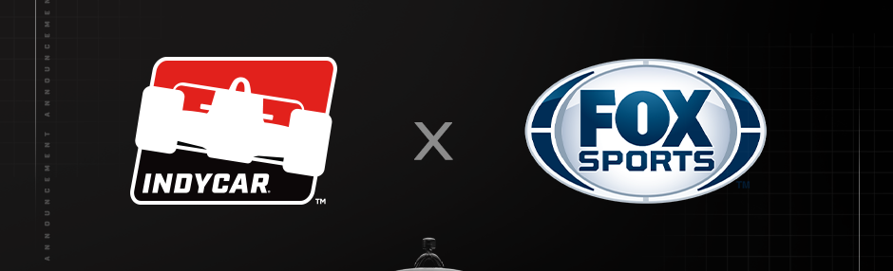
Background
Announcement Date: June 2024
Partnership: INDYCAR and FOX Sports
Start Date: 2025
Significance: Exclusive broadcaster for the NTT IndyCar Series and the Indianapolis 500

Slide 3
Key Terms
Exclusive Broadcast Rights: All IndyCar races, including the Indy 500, exclusively on Fox
Multi-Platform Coverage: Races available on Fox Sports app and Fox Deportes for Spanish-language coverage
Record Broadcast Windows: 19 broadcast network windows, the highest in series history
Supplemental Coverage: Practice and qualifying sessions on FS1 and FS2; most Indy NXT by Firestone races on FS1

Slide 4
Impact
Increased Exposure: Unprecedented level of exposure for IndyCar
Broader Audience: Appeal to younger, digital-first viewers
Enhanced Fan Engagement: More opportunities for fans to engage with practice and qualifying sessions

Slide 5
Growth
Higher Viewership: Increased audience through Fox's broad reach
Increased Sponsorship and Advertising: More visibility attracts advertisers and sponsors
Commercial Partnerships: Enhanced visibility can attract new commercial partners

Slide 6
Driving the Deal
Rising Popularity of IndyCar: Growing attendance and digital engagement
Strategic Fit for Fox Sports: Complements Fox’s portfolio of premier sports events
Technological Innovation: Advanced broadcast technology to enhance viewer experience

Slide 7
Industry Significance
Setting a Precedent: Potentially influencing future motorsports media rights deals
Boosting Women’s Sports: Highlights the value of diverse sports properties
Adapting to Consumption Trends: Acknowledges shift towards digital streaming

Slide 8
Financial Implications
Significant Investment: Substantial financial commitment from FOX Sports
Increased Revenue: Expected to attract more advertisers and generate higher advertising revenues
Exclusive Nature: Likely to drive higher viewer engagement and further boost revenues

Slide 9
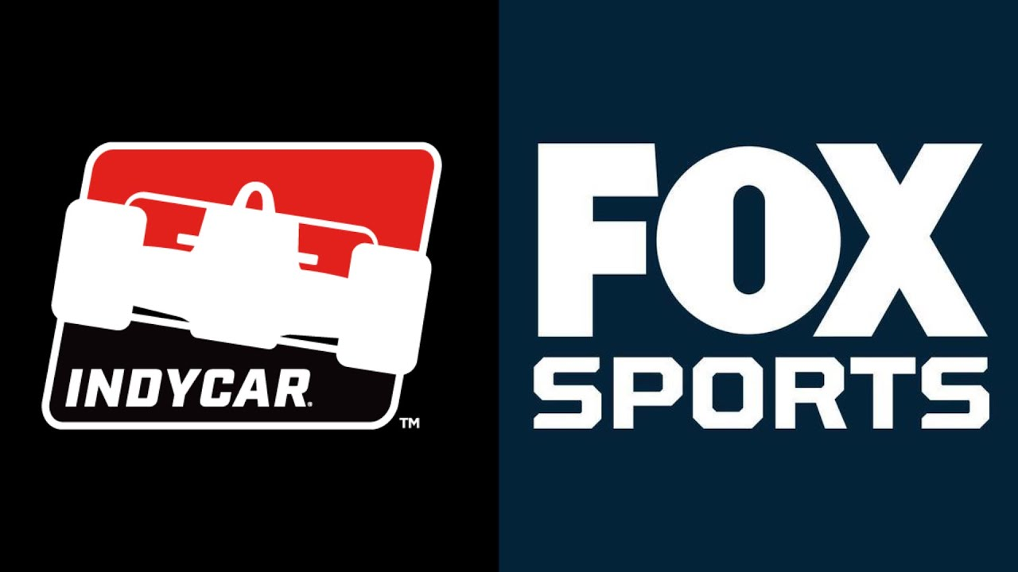
The End or Just the Beginning

